Slide 1
AWT Software Development Requirements Document

Slide 2
Request Item Number | Features
all | Gen/New Waveform (Sine、Ramp、Triangle、Sawtooth、Pulse、Gaussian Noise、DC)
all | Real time data display, signal analysis and control.(with Instrument)
all | No limitations in signal length, sampling rate or number of signals processed in parallel
all | Single Cursor: Used to measure the signal properties at a single point. Dual Cursors: Used to measure the time difference, frequency difference, or amplitude difference between two points. You can use the mouse to click and drag to adjust the cursor positions. 1. Harmonic cursor. 2. Sideband cursor. SIGVIEW Support: Mouse Functionality: The mouse functionality in SIGVIEW allows you to interact directly with signals. By moving the mouse over the signal graph, you can view the signal value at the cursor position and quickly measure data at specific time points.

Slide 3
Request Item Number | Features
all | Import and export of signal files in numerous formats: 1. AWG (D10 only) 2. Binary Parallel/Serial (D10 only) 3. CSV 4. Excel
all | 1. Exporting Window Content as Image. (png、jpge、bmp) 2. Changing Signal Value. 3. Image Editor.(Drawing or Text On Image)
x | Persistence signal display.
1:19 | Waveform Calculator、 Preprocessing Functions: 1.Add 2.Sub 3.Mult 4.Div (Wf/Const or Const/Wf) 5.Clip 6.Clip Bipolar 7.Shift 8.Boolean (Mask) 9.X Offset 10.Norm (Normalizes) 11.Abs 12.Filter Waveform 13.Windowing 14.Differentiation 15.Integration 16.FFT/IFFT 17.Linear/Circular 18.Convolve 19.Modulate SIG VIEW Support: 20.Baseline Correction 21.Smoothing 22.Zero-padding 23.Decimation 24.Resampling 25.Detrending 26.Envelope Detection
all | Waveform Arithmetic:1. Add2. Sub3. Mult4. Div5. Reverse6. Clip

Slide 4
Request Item Number | Features
 | Waveform Math:1. Polar 2. Rectang 3. Log 4. Power 5. Sqrt 6. Histogram 7. Average 8. Interleave 9. Deinterleave 10. Encode/Decode 11. Mux 12. Demux 13. Reorder 14. Split 15. POLAR Splice 16. CRECT Splice
x | Statistic Report
 | Spectrum Types: 1. Amplitude Spectrum 2. Power Spectrum 3. Phase Spectrum 4. Single-sided Spectrum 5. Double-sided Spectrum 6. Logarithmic Spectrum 7. Spectrogram 8. Power Spectral Density(PSD) 9. Coherence Spectrum 10. Cross Spectrum 11. Cumulative Spectrum
 | Windowing:1. Rectangular 2. Triangular 3. Hamming 4. Hann 5. Blackman 6. Flat-Top 7. Kaiser 8. Chebyshev SIGVIEW Support: 9. Gaussian 10. Tukey 11. Bartlett 12. Exponential 13. Lanczos

Slide 5
Request Item Number | Features
SIGVIEW Options | Segment: D10 Options:1. Create a new waveform from the TOS waveform. SIGVIEW Options:1. auto segment 2. selection a segment and processing 3. multi-segment manager(e.g. naming、mark) 4. save segment to new file(awg、binary、csv、excel) 5. Overlap Setting 6. multi-segment batch processing(e.g. Filter、FFT…)
all | Overlays: Parallel View、Overlay View 1. Parallel View 2. Overlay View
all | DSP Measurement Functions: (Reference D10 Options) 1. Ratios 2. Ratios (Filt) 3. INL/DNL (Ramp)4. INL/DNL (Sine)5. IntermodDist6. SineCurveFit7. Group Delay
x | Pulse Functions: All、Amplitude Rising/Failing Overshoot、Settling Time、Serial to Parallel、Parallel to Serial
x | Filter Waveform: High pass、Low pass、Band pass、Band Stop、C Message、Psophometric、Brick Wall

Slide 6
Request Item Number | Features
 | Create the user script Shell (Executing User Scripts)
Select one: | Ways to Manage Waveforms: 1. D10 Manages Using TOS Waveform Method 2. SIGVIEW Manages Using Control Window Method
x | Peak Detection

Slide 7
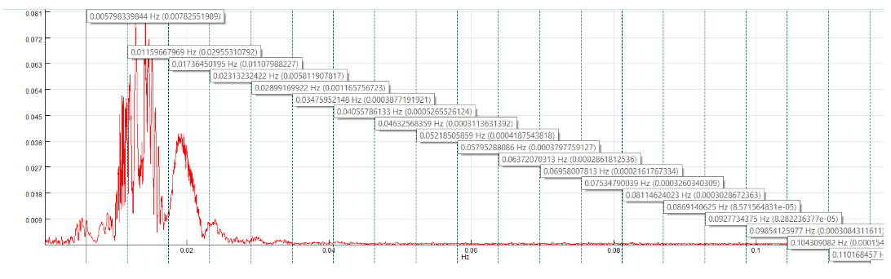
Harmonic cursor
By turning the Harmonic cursor option on in the context menu of FFT-based and signal calculator windows, a cursor will be shown on the current position of the mouse cursor as well as on all harmonics of the current frequency (current frequency x2, x3, x4, etc.)

Slide 8
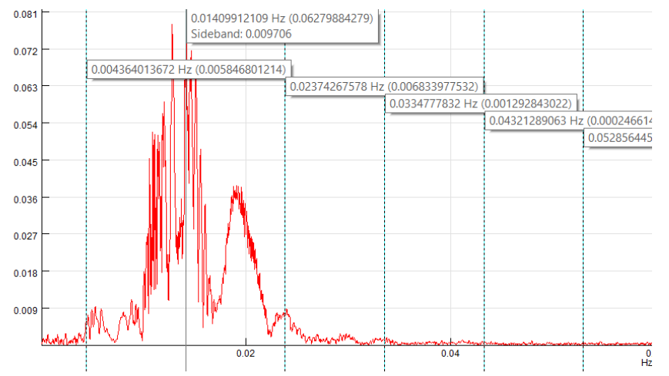
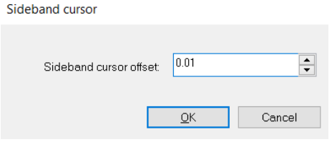
Sideband cursor
Sideband cursor function displays additional cursors at defined offset frequencies to both side of the base cursor. Sideband cursors are displayed at multiples of a fixed offset/distance from the base signal cursor. You can turn sideband cursor on or off by using by using a context menu option

Slide 9
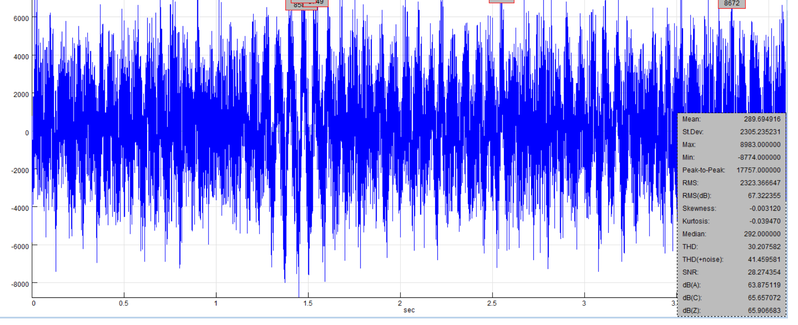
Statistic Report

Slide 10
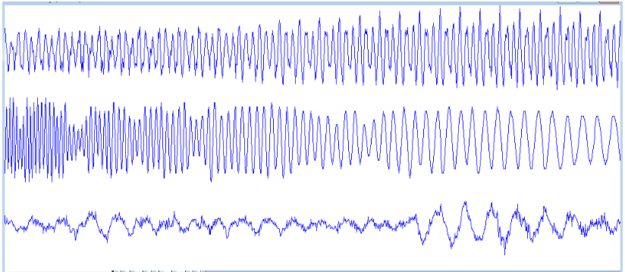
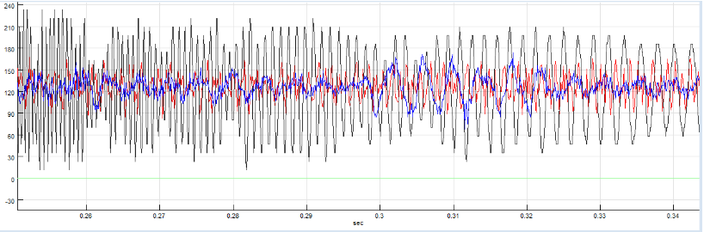
Overlays
Parallel
Overlay

Slide 11
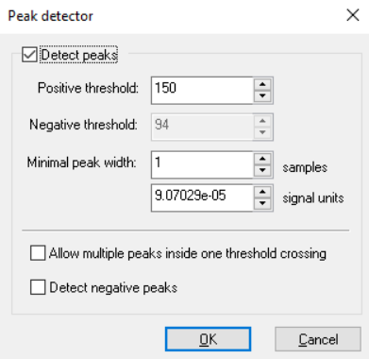
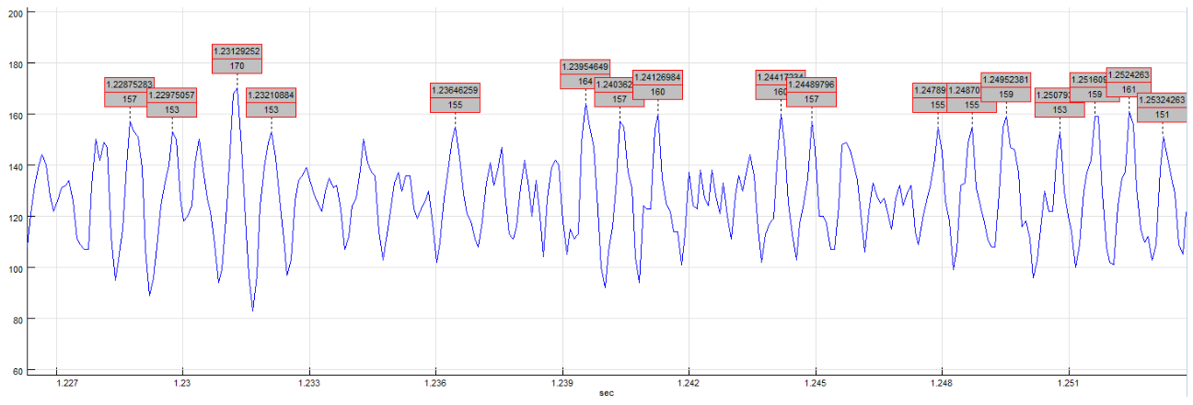
Peak Detection
The peak detection function is used to automatically detect peaks in a signal or in an analysis result. It can be started for each signal window from its context menu (right mouse click) or from the main menu option

Slide 12
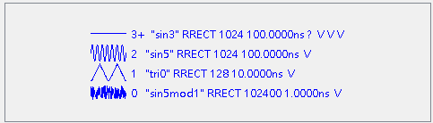
D10 Manages Using TOS Waveform Method
The Stack menu displays the current state of the waveform stack with status information about each entry on the stack. This information is also displayed in the lower right corner of the Analog Wavetool. The data is printed in the same color as its corresponding waveform.
The stack index number shows the relative location in the stack of the waveform. The index of the top of stack waveform is zero, the next to top of stack waveform has an index of one, and so on. A "+" following the index shows that at least one cursor is attached to the waveform. The letter "S" shows that the waveform is superimposed on the TOS waveform. The waveform name is listed followed by the type. "R" is a real rectangular waveform, Cr and Ci are complex rectangular waveforms with the real or imaginary component displayed, Pm and Pp are a polar waveforms with magnitude or phase displayed. The number of points in the waveform is displayed next followed by the sample interval and vertical units.
For waveforms currently connected to a tester, additional information is displayed: The tester read mode is the current read mode: Read, Auto Update, or Retrace. The command file identifies the command file that is currently specified and enabled. If a command file is specified but not enabled, no command file is listed in the stack display.

Slide 13
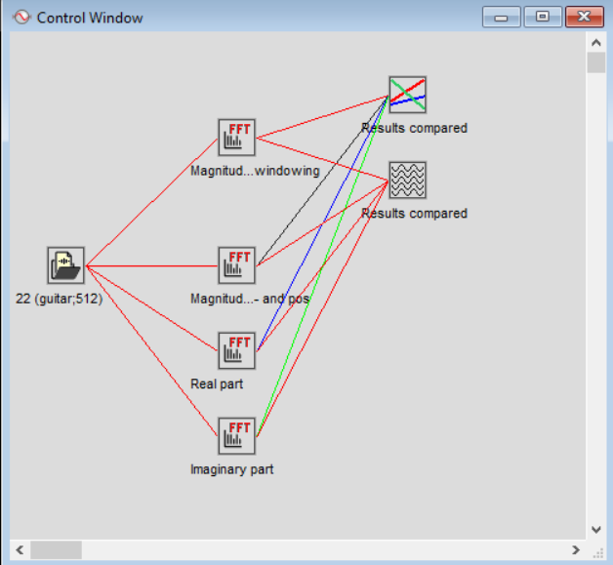
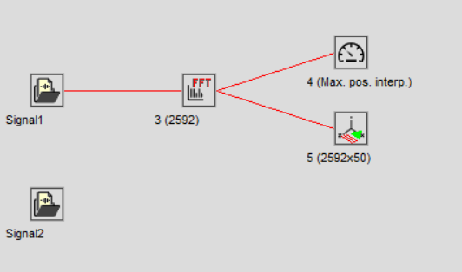
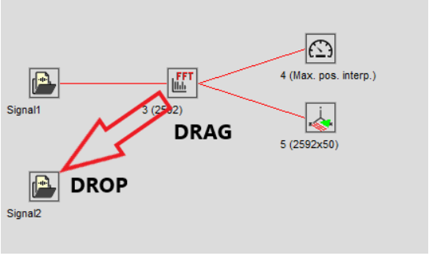
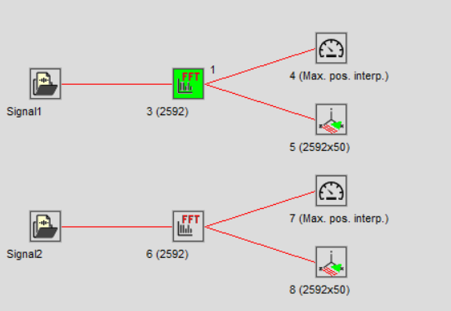
SIGVIEW Manages Using Control Window Method
The Control Window provides a graphical overview of your current analysis scenario, and enables you to work easily with many signals or analysis windows at the same time. Each signal, analysis window, 3D graphic, or instrument created while working with SIGVIEW is represented with its icon in a Control Window.

Slide 14
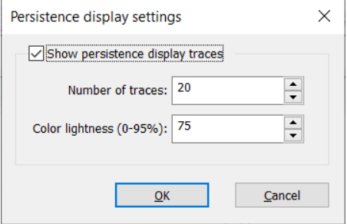
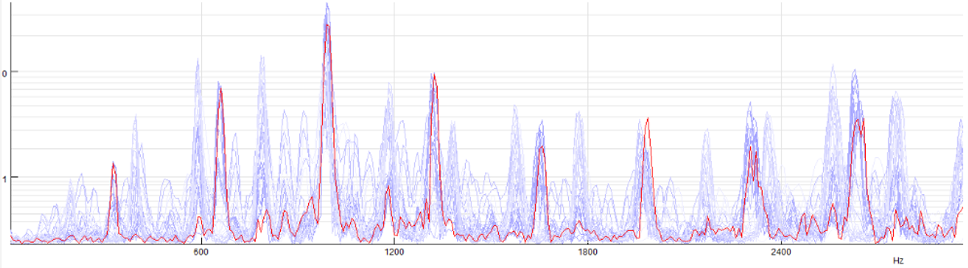
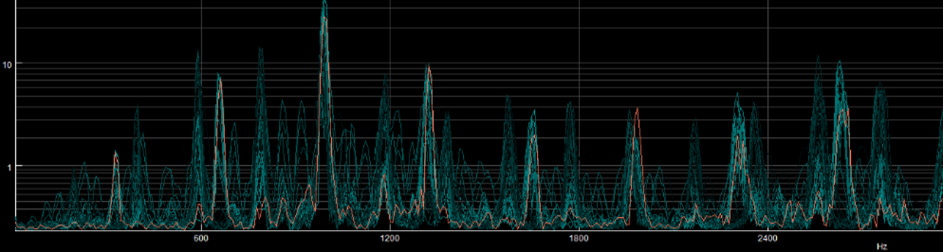
Persistence signal display
The software feature known as "Persistence Display" enhances analysis window display by allowing users to view historical signal values overlaid on current data. This function operates by gradually fading out older data points to give prominence to newer measurements, creating a visual history of signal changes over time. It's particularly useful in identifying patterns, trends, and transient phenomena that might otherwise be missed in real-time analysis. By retaining past signal values on the graph, users gain insights into the temporal dynamics of the signals they are monitoring, making it easier to compare current data against historical performance. The Persistence Display serves as a powerful tool for in-depth signal analysis, providing a comprehensive view of signal behavior over extended periods.

